Slide 1

Cookie Business Analysis
Answering queries using Access DB , analyzing with PowerBI
-Lakshmi

Slide 2
Introduction
Purpose of the Presentation: Answer the cookie business queries related to customers, orders and products using Access DB Queries. Analyze and visualize the cookie business using data from queries using Power BI.

Slide 3
Data Sources and exporting to tables
Customers Table:
Fields: FirstName, LastName, Email, Address, Phone, City, State, Zip, Country, Notes
Data Types: Text (for most fields), Number (for Zip)
Orders Table:
Fields: CustomerID, ProductID, OrderDate, CookiesOrdered, PricePerCookie, Revenue, OrderFilled
Data Types: Number (for CustomerID, ProductID, CookiesOrdered, PricePerCookie, Revenue), Date/Time (for OrderDate), Yes/No (for OrderFilled)
Products Table:
Fields: CookieID, CookieName, Price
Data Types: Number (for CookieID), Text (for CookieName), Number (for Price)
Establishing Relationships
Customers to Orders: Create a one-to-many relationship between Customers and Orders. The primary key in Customers (e.g., a unique customer ID) should be the foreign key in Orders.
Products to Orders: Create a one-to-many relationship between Products and Orders. The primary key in Products (e.g., a unique cookie ID) should be the foreign key in Orders.

Slide 4

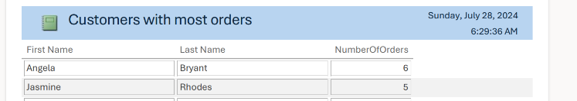
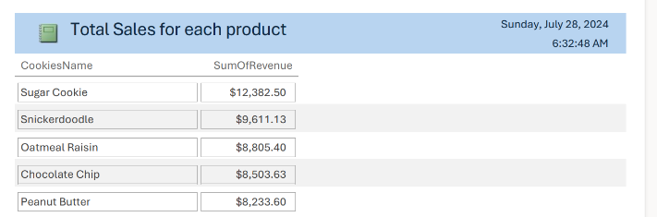

Answering Queries using Access DB

Slide 5
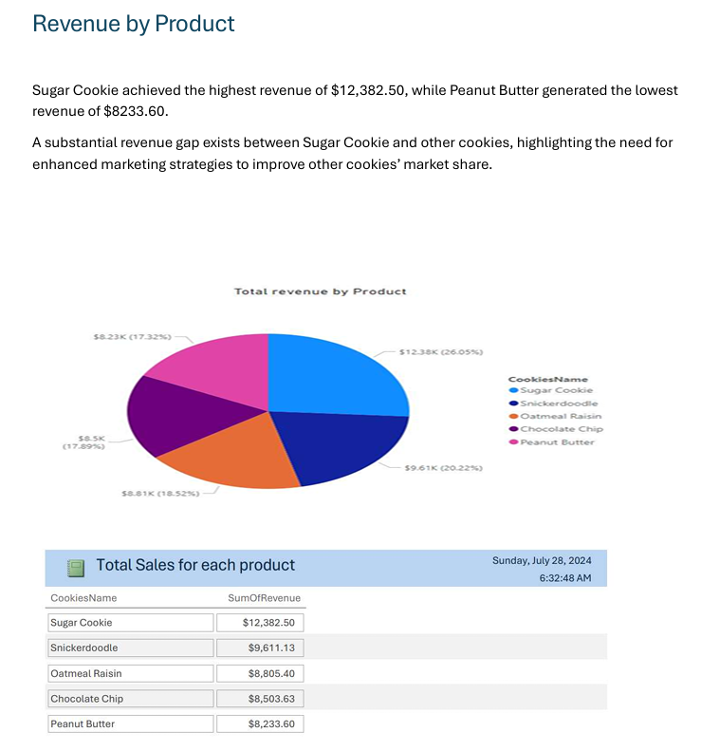
PowerBI reports

Slide 6
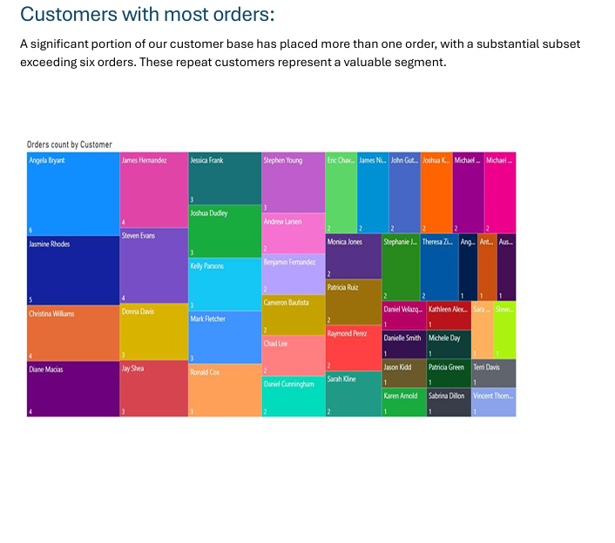
PowerBI reports

Slide 7
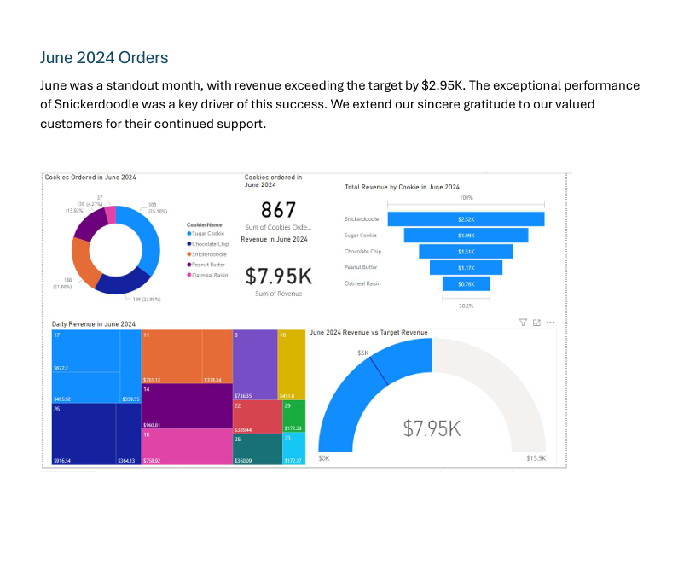
PowerBI reports

Slide 8
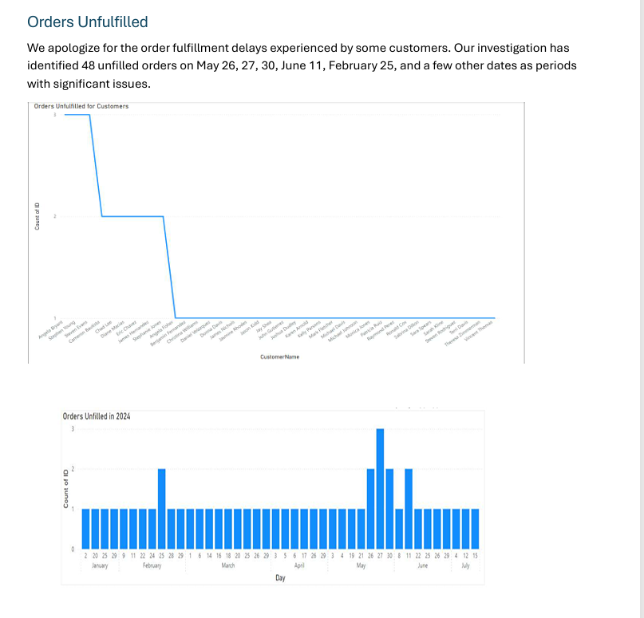
PowerBI reports

Slide 9
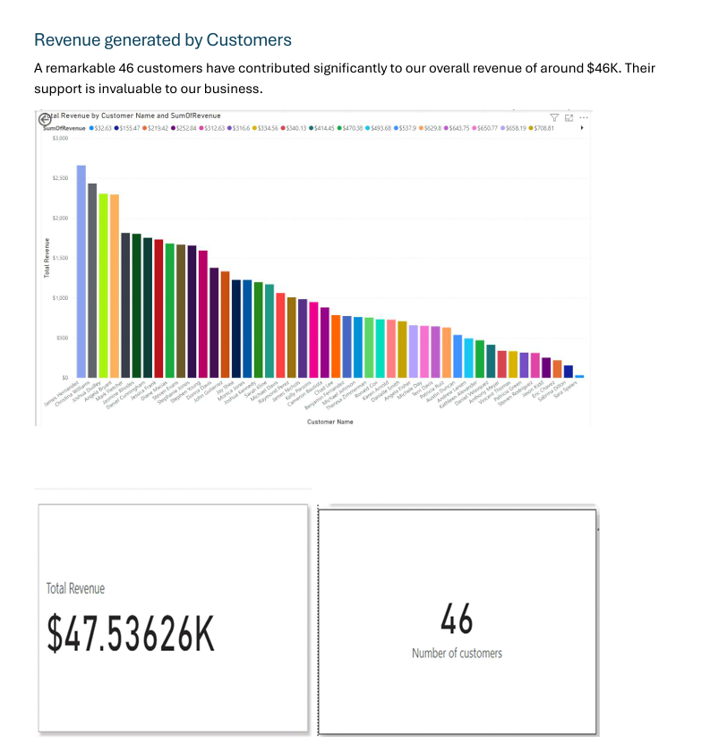
PowerBI reports

Slide 10
Thank you

